Slide 1

Paramveer singh.2329051

Slide 2
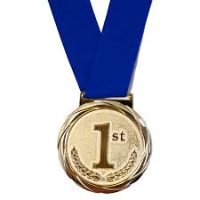
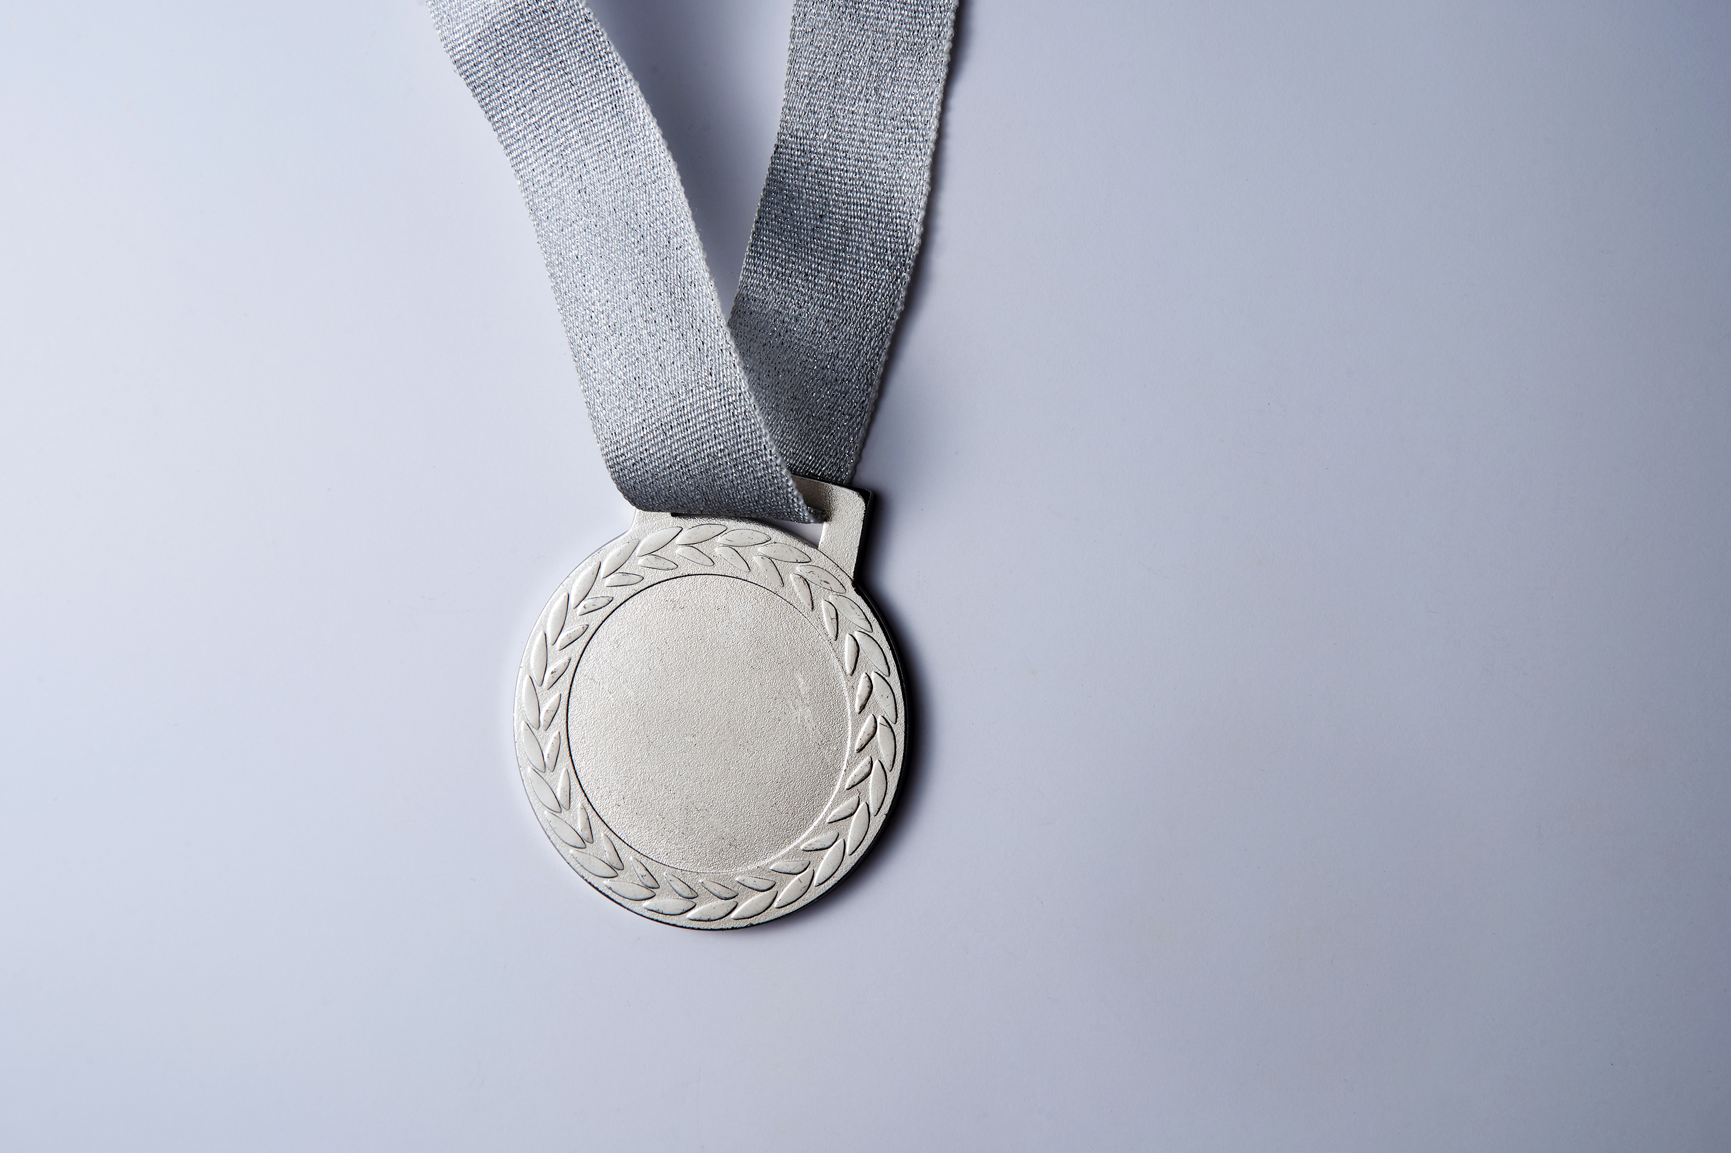
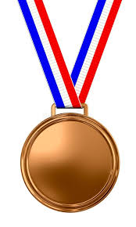
Canadian athletes have achieved outstanding success in international competitions, showcasing their exceptional talent and dedication. They secured a total of 501 Gold medals, a remarkable testament to their excellence and dominance. Adding to their achievements, they earned 519 Silver medals, demonstrating consistent top-tier performances. Furthermore, Canadian athletes proudly claimed 566 Bronze medals, reflecting their resilience and determination to excel. These accomplishments highlight Canada’s strong presence in the global sports arena, inspiring future generations of athletes. Their success is a source of pride for the nation and a reminder of their commitment to excellence in sports.
501
519
566

